Slide 1
Face Recognition Based
Attendance System
Team Members:
Yogarathnam S 802367
John Bervin S 802340
John A B 802339
Athithyan A 802319
Guide:
Mr. J .Jenifer Jose M. Tech

Slide 2
ABSTRACTION:
The Smart Attendance System leverages face recognition technology and Machine Learning to automate attendance tracking in educational institutions and workplaces. Traditional attendance methods are often inefficient and prone to errors, leading to time wastage and inaccuracies. This system utilizes advanced image processing techniques to recognize individuals' faces in real-time, ensuring accurate and quick attendance logging. By integrating Machine Learning, the system enables seamless data collection and reporting, enhancing the overall efficiency of attendance management. The proposed solution aims to reduce administrative burden, improve accuracy, and provide valuable insights through attendance analytics.

Slide 3
OBJECTIVE
Automate Attendance Tracking: To develop a system that automatically records attendance using face recognition technology.
Enhance Accuracy: To minimize errors associated with manual attendance methods.
Real-Time Reporting: To provide instant attendance reports accessible through a web interface.
User-Friendly Interface: To create an intuitive user interface for both administrators and users.

Slide 4
EXISTING SYSTEM
Existing systems rely on traditional methods, such as RFID-based classification or barcode scanning, to mark attendance. These systems do not incorporate facial detection algorithms like Haarcascade or computer vision techniques, making them less effective in detecting or recognizing individuals visually. RFID and barcode systems typically verify individuals using basic classification algorithms, which can lead to issues like unauthorized or proxy attendance. Moreover, such systems lack the ability to handle varying lighting conditions or complex backgrounds that facial detection algorithms like Haarcascade can handle, resulting in reduced flexibility and robustness compared to modern face recognition-based systems.

Slide 5
EXISTING SYSTEM
Manual Attendance: Traditional methods involve roll calls or sign-in sheets, which are time-consuming and prone to human error.
ID Card Systems: Some institutions use ID cards with RFID technology, but these can be lost or forgotten, leading to inaccuracies.
Biometric Systems: Fingerprint recognition systems are used but can be slow and require physical contact, which may raise hygiene concerns.

Slide 6
Disadvantages of Existing System:
Human error
Manual data entry can be prone to error, which can lead to incorrect attendance percentages and other issues.
Time-consuming
Manual attendance systems can be time-consuming, especially when managing large groups of students.
Increased absenteeism
Manual attendance systems can lead to an increase in fake leaves and absenteeism, which can negatively impact a company's productivity.
Difficult to manage
Manual attendance systems can be difficult to manage, especially for large groups of students

Slide 7
PROPOSED SYSTEM
The proposed system utilizes Machine Learning-based Face Recognition with the Haarcascade Frontal Face Algorithm for automatic attendance marking. The system first uses the Haarcascade algorithm, a popular object detection method based on Haar features, to detect faces in real-time from a video feed or images.
Once the face is detected, advanced machine learning models extract facial features and encode them into numerical vectors, which are then classified against a database of known identities using algorithms like Support Vector Machines (SVM).This hybrid approach enhances the detection speed and accuracy, ensuring that attendance is recorded only when a face matches a pre-registered identity. The system is robust, scalable, and capable of learning continuously to improve recognition accuracy over time.

Slide 8
Advantages of Proposed System
Accuracy
Face recognition systems are more accurate than manual or other biometric systems and can prevent time theft.
Security
Face recognition is difficult to duplicate or hack, and it ensures that the person being identified is physically present.
Efficiency
Face recognition systems are automated, which reduces the need for manual recording or swipe cards.

Slide 9
Advantages of Advantages of Proposed System
Proposed System
Contactless
Face recognition systems are a hygienic and contactless way for employees to mark their attendance.
Cost-effective
Face recognition systems can save business resources by automatically tracking employee time.
Adaptability
Face recognition systems can adapt to various lighting conditions.
Easy to use
Face recognition systems are easy to manage compared to manual attendance systems.

Slide 10
System Requirements:
Hardware Requirements:
WebCam
Intel i5 Processor
RTX2050
Software Requirements:
Library: OpenCV,Numpy,Pandas,Scipy
Excel – CSV File
IDE – VS Code
Windows 11
Algorithm:
Haarcascade algorithm, Adaboost Algorithm

Slide 11
Module Description:
MODULES:
Module 1:
Add New User
This module allows administrators to create new user accounts within the system. It ensures that all necessary user information is collected and stored securely, and it can be customized to fit specific organizational needs.
Module 2:
Attendance Registration
This module allows face recognition for attendance is an innovative and efficient method that leverages biometric technology to track attendance accurately.
User Name
User Id

Slide 12
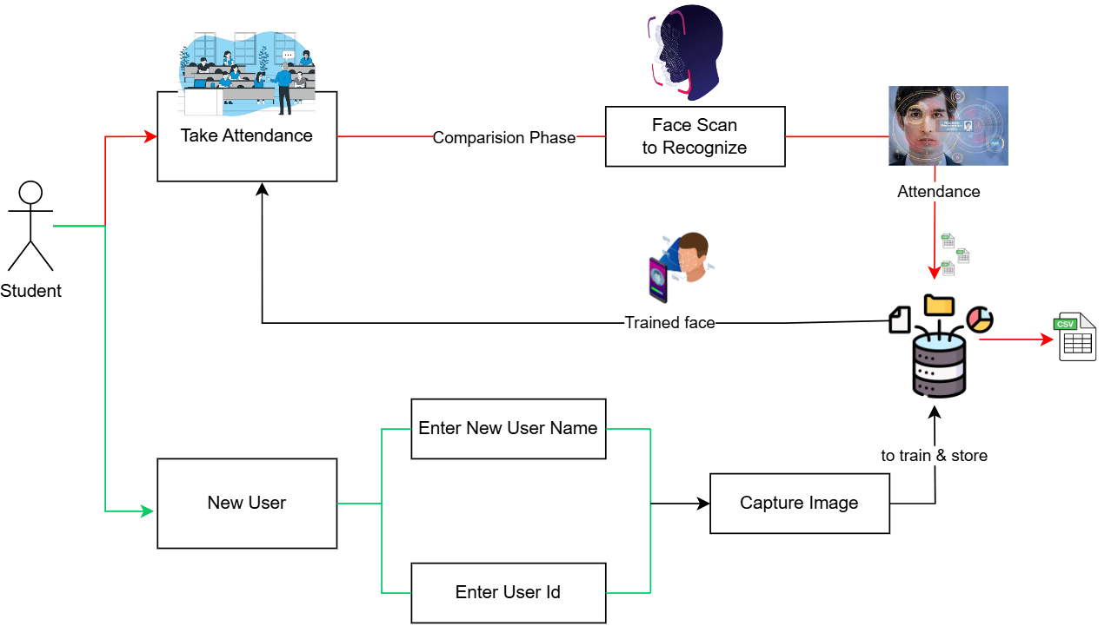
SYSTEM ARCHITECTURE

Slide 13
CONCLUSION:
The proposed Smart Attendance System using Face Recognition and Machine Learning aims to revolutionize attendance management by providing a more efficient, accurate, and user-friendly solution. Through the integration of advanced technologies, this system addresses the limitations of existing methods and offers significant benefits to educational institutions and workplaces. By continually evolving and incorporating user feedback, the system can adapt to changing needs and further enhance the overall experience for both users and administrators. Ultimately, this innovative approach has the potential to transform attendance management into a seamless, automated process.

Slide 14
FUTURE ENHANCEMENT:
Future enhancements for the Smart Attendance System using Face Recognition and Machine Learning could include multi-factor authentication for improved security, real-time analytics to provide insights into attendance trends and student performance, and integration with existing Learning Management Systems (LMS) for seamless data sharing. It allow users to easily check their attendance records and submit leave requests. Additionally, incorporating anomaly detection algorithms can help identify unusual attendance patterns, while enhanced privacy features would allow users to control their data.

Slide 15
THANK YOU ! ! !

